Slide 1

PROMOTION OF CHANGE IN THE 2017 NURSE PRACTICE ACT
RESTORE SAFE DELEGATION LANGUAGE BY PASSING SB 1990

Slide 2
PROBLEM STATEMENT/IDENTIFICATION
Problem Statement
Lowering the Standards in the 2017 Nurse Practice Act (NPA) by the conveners of the NPA has opened the door for unlicensed non nurses’ individuals to replace Registered Professional Nurses in the community setting. The delegation language was changed to allow non nurses to do nurses interventions including medication administration. The changes in the Nurse Practice Act has created health disparity, unqualified persons to practice nursing which violates the legislative purpose.
Identification
The conveners of the Nurse Practice Act (NPA) allowed less than 25 small groups to decide the outcome of the Nurse Practice Act in 2016.The new Nurse Practice Act became affected in 2017.
The outcome was decided by votes and not consensus.
The participants of the NPA lack direct care nurses and union nurses' participation.
One small group was a nursing agency that decided on the language for the NPA.
The delegation language was changed to allow non nurses in community settings to do nursing interventions. (see the NPA 2017).
The definition of a nurse was changed in the Nurse Practice Act. (see the NPA 2017).
A Medication Pilot was passed to prepare other unlicensed people to administer medication, but the pilot failed.
The definition of nurses were changed or removed to allow other groups like MAs to replace nurses in the community setting.
The clinics removed or laid off nurses and replaced them with MA’s.
The request now is for LPNs in some agencies and not Nurses due to cost factors. The care is determined by cost and not patient needs/acuity.
The restructuring of the nurse's work environment has led to a shortage in some areas.
Legislation was passed by the Black Caucus that creates another type of health worker and leaves the nurses out by not naming nursing as part of the team. (HB0158).
SB 1990 was created by the Chicago Chapter National Black Nurses Association Health Policy Committee to fix the 2017 Nurse Practice Act. This bill could restore public safety and delegation language in the Nurse Practice Act.
Legislation by the Chicago Chapter health policy committee has been in place since 2017 as a result of the conveners(ANA-ILL) of the NPA lowering the standard of the nurse Practice Act and not communicating with the nurse's community in Illinois.
The legislative number of the Chicago Chapter bill changed every two years due to the protocol in Springfield Illinois. SB339; SB 2151; and now SB 1990.

Slide 3
SOURCE OF THE PROBLEM
100TH GENERAL ASSEMBLY State of Illinois 2017 and 2018 HB0313 Introduced , by Rep. Sara Feigenholtz
Amends the Regulatory Sunset Act. Extends the repeal of the Nurse Practice Act from January 1, 2018, to January 1, 2028. Amends the Nurse Practice Act. Defines "focused assessment", "full practice authority", "oversight", and "postgraduate advanced practice nurse". Changes references of "advanced practice nurse" and "APN" to "advanced practice registered nurse" and "APRN" throughout the Act. Replaces provisions regarding nursing delegation with provisions that prohibit specified actions. Provides other guidelines for delegation of nursing activities and medication administration. Makes changes to education program requirements, qualifications for licensure, the scope of practice, and continuing education for LPN and RN licensees. Provides that a written collaborative agreement is required for all postgraduate advanced practice registered nurses until specific requirements have been met. Provides that postgraduate advanced practice registered nurses may enter into written collaborative agreements with collaborating advanced practice registered nurses or physicians (rather than collaborating physicians or podiatric physicians). In provisions concerning prescriptive authority for postgraduate advanced practice registered nurses, sets forth the requirements for postgraduate advanced practice registered nurses to have prescriptive authority and the limitations of such authority. Makes changes to provisions concerning the grounds for disciplinary action under the Act. Requires the Department of Public Health to prepare a report regarding the moneys appropriated from the Nursing Dedicated and Professional Fund to the Department of Public Health for nursing scholarships. Makes other changes. Effective immediately.

Slide 4
TALKING POINTS TO FIX HB 313/SB625
CURRENT Illinois Nurse Practice Act ensures safety:
Determinants in the Nurse Practice Act law allows a registered nurse to practice nursing: only after successful completion of their nursing education and achieving licensure. Only qualified educated and licensed nurses are to practice nursing, that includes the complex activity of medication administration.
Nurse Practice Act law: prohibits non-nurses from practicing nursing and prohibits registered nurses from delegating nursing work that requires nursing knowledge. Non-nurses do care for the patient in all settings and are assigned “tasks” by the registered nurse. “Tasks” are currently defined as work that does not require nursing knowledge in the act.
Nurse Practice Act “Rules” defines medication administration as licensed nursing work requiring nursing knowledge from an approved nursing curriculum. Medication administration requires graduation from an approved nursing education and licensure and cannot be delegated to non-nurses and includes the community setting.
This distinction of work identified by educational preparedness and licensure is found in the nurse practice act definitions and are the foundation for registered nurse’s decision making when delegating. Definitions in the Illinois Nurse Practice Act are purposefully clear and unambiguous. Definitions of “task” and “nursing activity” which describes work delegated by the registered nurse to unlicensed or licensed persons. Nurses can only delegate nursing work within their scope of practice to those who’ve graduated from an approved nursing education and possess a valid nursing license.
The registered nurse in the community setting provides access to qualified registered nursing care to the public. The American Nurses Association Value of Nursing Care Coordination white paper demonstrates how registered nursing services improve patient outcomes & lower overall costs. RN interaction with patients affords patient care coordination, in-depth patient assessment and interviews, patient/family education and care planning, medication management and proper medication therapy education especially in chronic illness management. http://www.nursingworld.org/carecoordinationwhitepape
TALKING POINTS TO FIX HB 313/SB 625
Proposals in HB 313/SB 625 that endanger patients!
HB 313/SB 625 unlicensed persons have no educational component to practice nursing including the administration of medications in the community setting. HB 313/SB 625 will allow Registered nurses to delegate nursing to unlicensed persons who have no nursing education or licensure to practice nursing. Language in HB 313/SB 625 has removed “task” and “nursing activity” and replaced it with one ambiguous definition of “nursing intervention” that defines registered nurse delegation of work that includes possessing “clinical nursing judgment that a nurse performs”. HB 313/SB 625 will allow unlicensed persons to administer medication.
Medication administration is a complex action which an unlicensed person has no education or license to perform. Medication administration by unlicensed persons in hospital setting is prohibited; HB 313/SB 625 will allow nurses to delegate medication administration in the community setting. The complexity and dangers of medication administration is equal both inside or outside the walls of the hospital. Nurses are educated in pharmacology, appropriateness of medications and mitigate errors and mistakes.
Removing patient/registered nurse interactions (as will change the work environment in community settings if these proposals pass into law) will negatively impact the patient’s outcomes. The Community setting is a portal for access to health care services. Diminishing the level of qualified nursing services is not going to save money but increase costs with reduced care coordination, prevention of errors and teaching opportunities between patient & RN.
REMEDY: Restore definitions that outline work appropriate to be delegated to non-nurses, such as “task” that does not require nursing knowledge. Restore “nursing activity” that describes work to be delegated to licensed nurses within their level of nursing education, scope of practice and licensure. Restore that medication administration requires nursing knowledge and cannot be delegated to those who do not possess the nursing knowledge or education; including the community setting.

Slide 5
DOCUMENTION OF THE PROBLEM
Factsheets was created as a tool to train nurses about the Nurse Practice Act law and to highlight the problem with the New 2017 Nurse Practice Act.
Factsheets were revised when more or new information became available during the legislative year.
Factsheets were made available on the Chicago Chapter National Black Nurses Association Website for the members and the Public since 2017- 2022.
Factsheets were shared with nurses, other organizations, and stakeholders from 2017- 2022.
Factsheets and testimony were shared with legislators in Springfield Illinois from 2017- 2022.
Chicago Chapter NBNA sponsored a Nurse Lobby Day and walk on the Capitol to meet legislators in 2017 and distribute educational material on HB 0313.
Nurse Lobby Day and Training sessions in Springfield Illinois in 2020, and invited individual nurses, INA, NNU, Nurse Alliance Chapter, South Suburban Chapter, and Chicago Chapter National Black Nurses Association.
A Legislative forum was held in Chicago in 2018 to reestablish Chicago Chapter national Black Nurses Association on the state level to support nurses and patient safety in Illinois. Legislators running for office came and share information.
The grassroots action were captured on the Chicago Chapter National Black Nurses Association Website.

Slide 6
TOOL KIT FOR THE DELEGATION AMENDMENT &
SB 1990
Listed Factsheets and tools Created to change the Nurse Practice Act (NPA)
SB 339 Factsheet in 2017
SB2151Factsheet in 2019
SB 1990 Factsheet in 2021
THE NEW 2017 NURSE PRACTICE ACT
WITNESS SLIPS ON SUPPORTING OR OPPOSING LEGISLATION
COMMUNICATION DOCUMENT ON “HOW TO TALK WITH YOUR LEGISLATORS”
DOCUMENT ON HOW TO FIND YOUR LEGISLATORS- ALDERMAN; HOUSE OF REPRESENTATIVES; & SENATORS.
ZOOM TRAINING ON THE DELEGATION LANGUAGE AND SB1990 AMENDMENT FOR CHANGE
LEGISLATIVE LIST OF BILLS TO SUPPORT OR OPPOSE ON THE LOCAL, STATE, AND NATIONAL LEVEL.

Slide 7
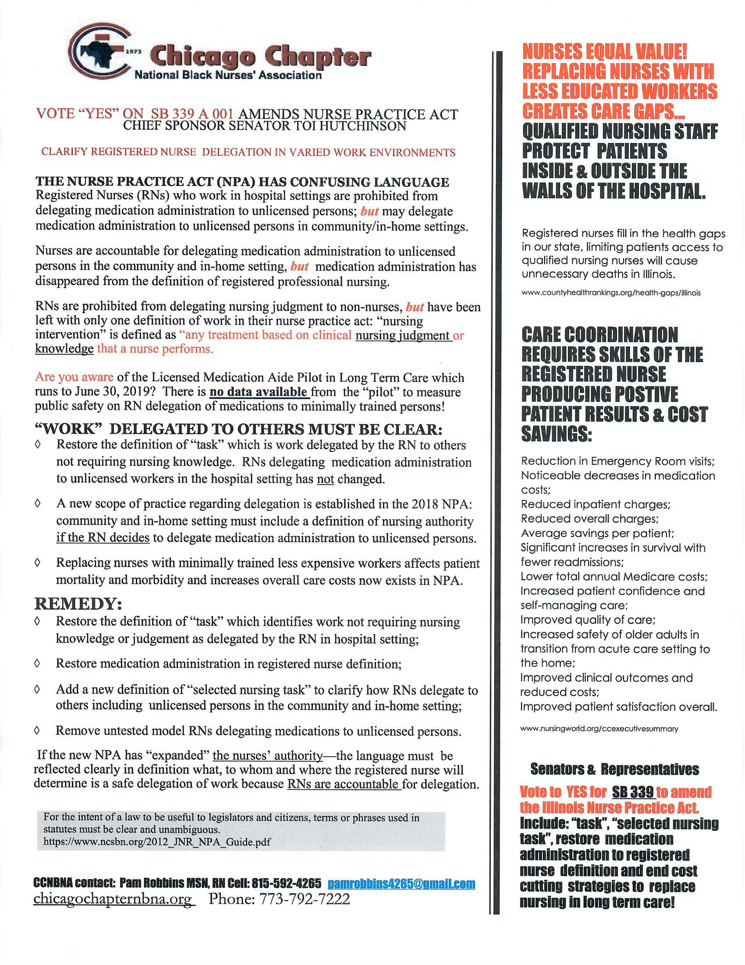
INTERVENTIONS FOR HB 339 Amendment 01

Slide 8
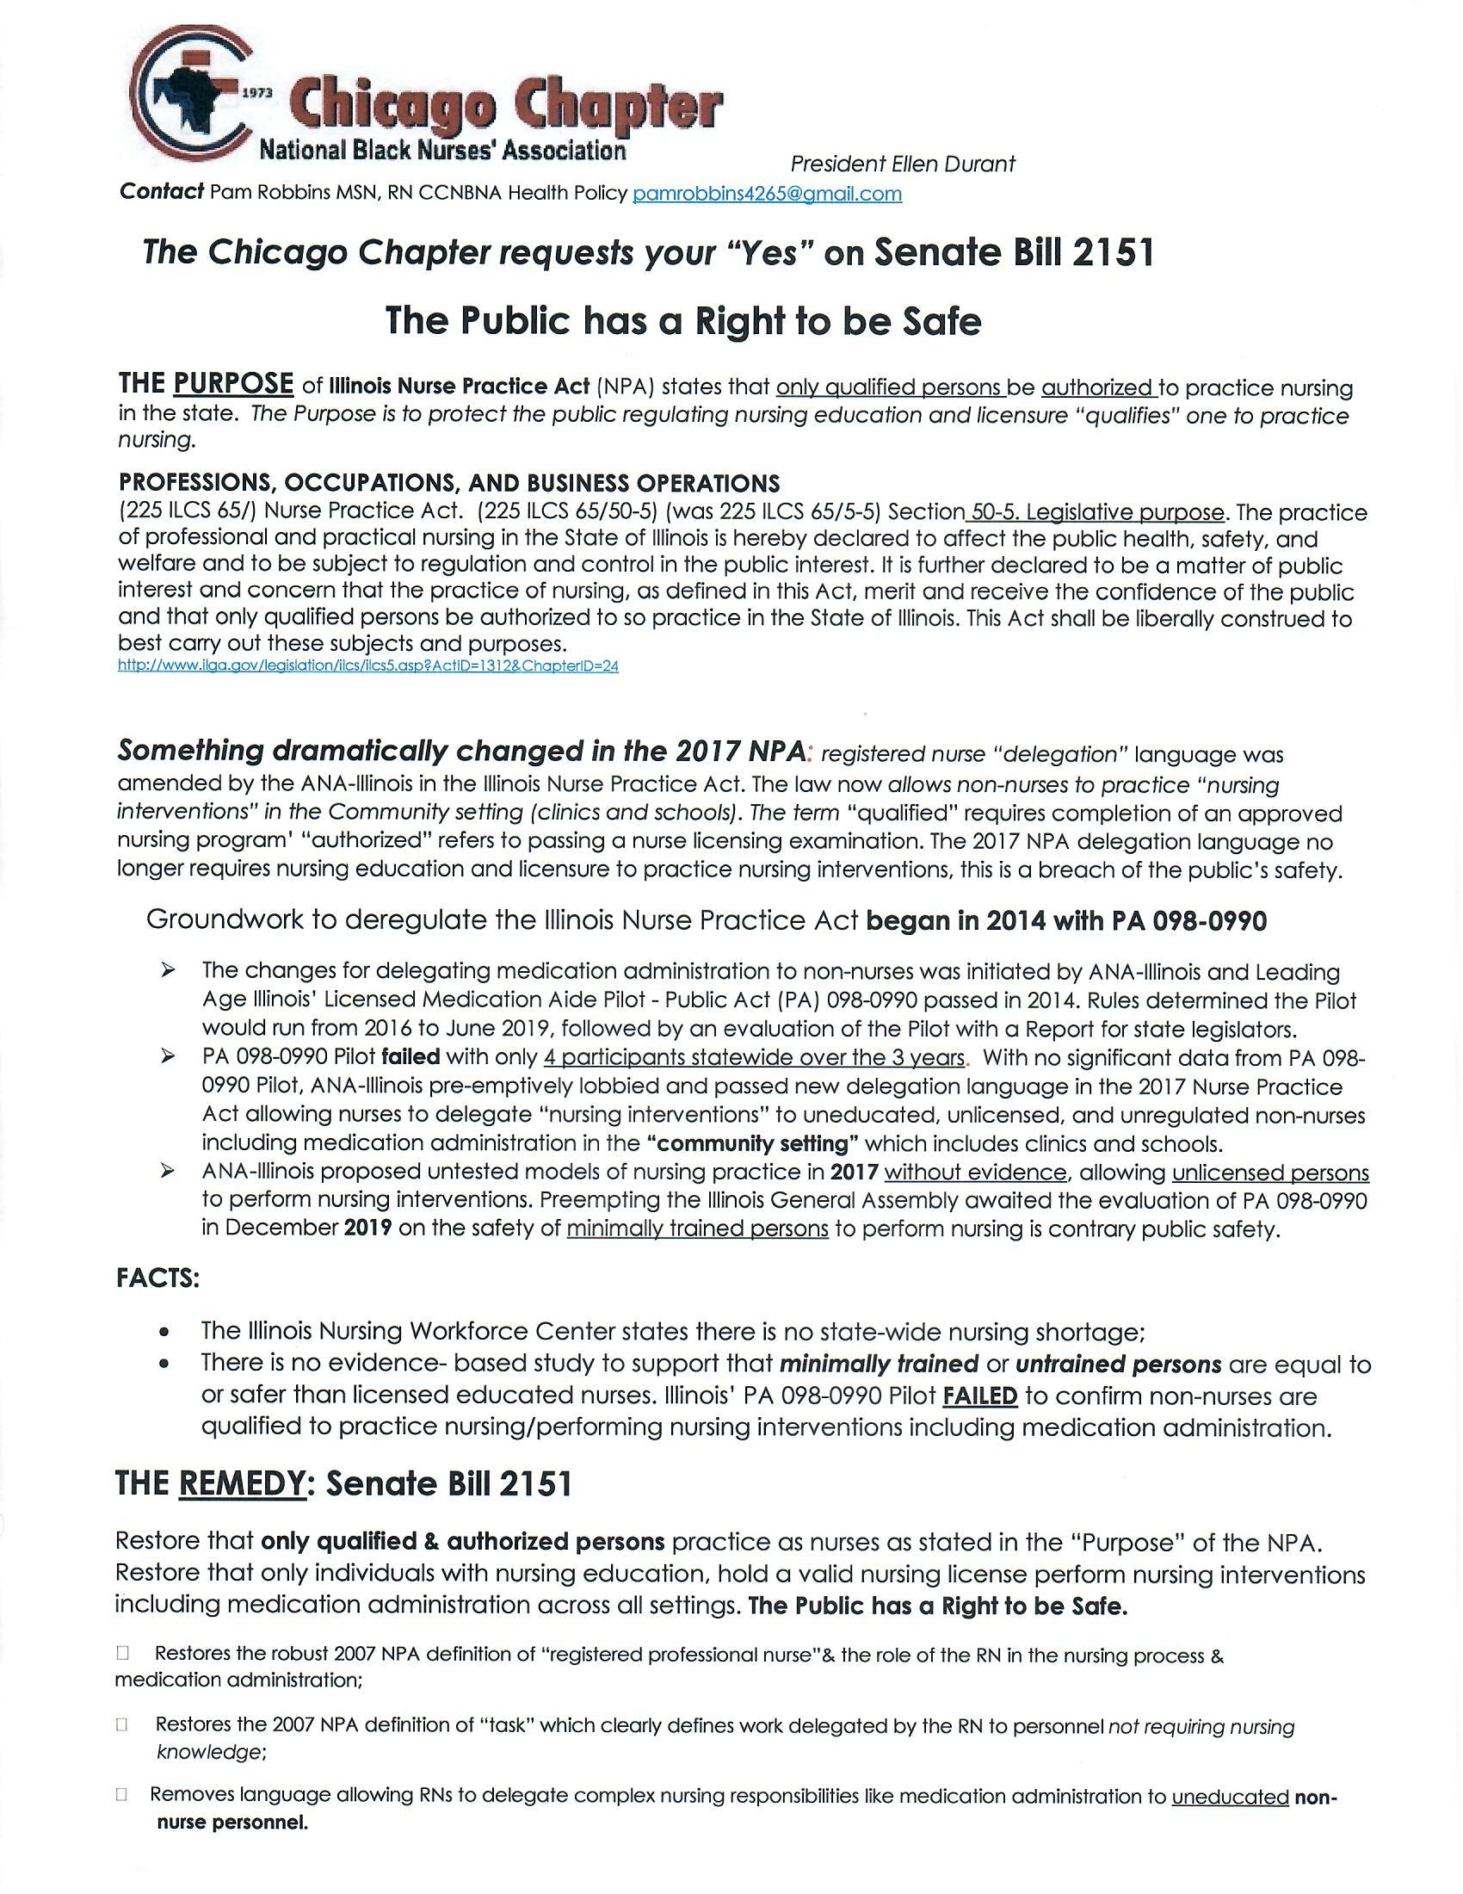
Interventions for SB 2151

Slide 9
INTERVENTIONS FOR SB 1990

Slide 10
SB1990 LEGISLATION FOR CHANGE
SYNOPSIS AS INTRODUCED: SB 1990 | Chicago Chapter National Black Nurses Association introduced SB 1990
102ND GENERAL ASSEMBLY State of Illinois 2021 and 2022 SB1990
225 ILCS 65/50-10
225 ILCS 65/50-75
225 ILCS 65/60-35
Amends the Nurse Practice Act. Provides that registered professional nursing practice is a scientific process founded on a professional body of knowledge; it is a learned profession based on the understanding of the human condition across the life span and environment and includes all nursing specialties and means the performance of any nursing act based upon professional knowledge, judgment, and skills acquired by means of completion of an approved professional nursing education program. Provides that registered professional nurses may delegate nursing interventions and tasks (rather than nursing interventions) to other registered professional nurses and licensed practical nurses based on a comprehensive nursing assessment. Provides that registered professional nurses may delegate tasks to unlicensed personnel based on a comprehensive nursing assessment. Provides that a registered professional nurse is prohibited from delegating work requiring nursing knowledge, assessment, judgment, inference, decision making (including medication administration), the development of a plan of care, and the evaluation of a plan of care to unlicensed non-nurse personnel. Removes provisions concerning delegation of nursing interventions and administration of medications in community-based or in-home care settings. Makes other changes. Effective August 1, 2021 | The Health Policy Committee of the Chicago Chapter National Black Nurses Association Created new language in SB 1990 that will amend the unsafe language in the 2017 NPA.

Slide 11
INTERVENTIONS
Educated nurses on SB 1990 and delegation language to be amended.
The health Policy Committee of CCNBNA met on a regular basis to develop strategies to guide nurses and other groups on amending the delegation language in the Nurse Practice Act.
The health policy committee met on a regular basis with the Chief Bill sponsors for guidance on the process going forward.
The health Policy Committee joined forces with other stakeholders to move Nurses message and strengthen the grassroots movement for SB 1990.
Educated nurses on how to find information on the Illinois government website.
Educated nurses on how to fill out a witness slip to activate their voices.
Educated legislators in Springfield and home office on SB 1990
Stayed connected with Chief sponsors of SB 1990 for feedback and direction.
Members made visits to legislator's office and made phone calls.

Slide 12
HOW TO MAKE A WITNESS SLIP

Slide 13
GOALS AND OBJECTIVES
Health Policy Committee Goal
1 To develop the grassroots process and plan legislative activities for the CCNBNA membership at the local, state, and
National level.
To educate CCNBNA membership on how to influence policy by actively participating in Lobbying activities, the use of Webinars, on-line programs, and visiting legislators in Springfield or Washington DC.
3 To interpret legislation for the CCNBNA and provide a position of support or opposition
4 To establish a phone tree and email list to improve communication for the CCNBNA legislative activity
Committee Objectives:
The membership will call their representatives to convey their interest as nurses in the legislative process when alerts
go out to support or oppose issues or legislations.
2 The membership will share their legislative responses to the CCNBNA health policy leadership

Slide 14
Chicago Chapter NBNA BYLAWS
Monitor relevant health policies at local, state and national levels and advise members of ways they can be actively involved.
Inform the membership of proposed city ordinances, state and national legislative proposals for their implications for
nurses, nursing and health, with special emphasis given to Black nurses and Black health care consumers.
Make recommendations related to public health policy, as necessary, to the national organization upon approval of the
Board of Directors.
d. Promote and support National organization legislative programs and proposals.
Promote participation of Black nurses at legislative affairs consistent with stated Preamble and objectives of these
Bylaws.
Prepare and present to the board of directors a written annual evaluation of committee’s activities within 30 days at the
end of the fiscal year.

Slide 15
LEWIN CHANGE MODEL
Unfreeze- Becoming motivated to change or there is a driving force for change: initiate SB1990, Mentor, educate, training, support, and plan.
Change- This is the time to change what need to be changed: Nurses, students, and the public must activate or agitate for change by communicating with their legislators and others to support SB 1990. Raise your voices by filling out witness slips and sharing information with others and stakeholders.
Freeze- Going for the win to Pass SB1990 : Monitor SB 1990 witness slips on the State Website to see if others are filling out the witness slips. Contact the Chief sponsor and chairperson your committee is in; be ready to testify and share info to get bill out of committee and out of the General Assembly. The leadership will monitor, mentor and evaluate the process until change is made.
LEWIN
CHANGE
MODEL
CHANGE
FREEZE
UNFREEZE

Slide 16
THEORETICAL BASIS
System Theory
Inputs
Throughputs
Outputs
Feedback
The Following elements are common during an Open System Theory
INPUT- Matter, energy, and information is received from the environment or the community. Input would allow information from the nurse practice Act to be received from the conveners of the Nurse Practice Act and various nurse groups could give their opinions and energy to the issues brought up. The system used with the negotiation of the Nurse Practice Act was a closed system because only 25 small groups was allowed to participate, and information was closed off to the public.
THROUGHPUT- A small group of people received information of the Nurse Practice Act that was modified or transformed within a closed system. The large part of the nursing community was not allowed the opportunity to address the matter of Delegation to unlicensed non nurses. The conveners of the Nurse Practice Act did not allow for an open system.
OUTPUT- The matter and information is released from the system into the environment or the Community. During 2017 the conveners of the Nurse Practice Act released information to the community that was a surprise to the nursing community. Negotiation was done by a closed system where groups did not discuss with other groups during the discussion. The response was that it is a done deal.
FEEDBACK- This is information regarding the community response used by the system. Many nurses did not know that the Practice Act was negotiated, no information was sent during the negotiation process, nurses said things started to change but did not understand why; Most of the responses was Negative about the change in the Delegation language.
A change in one part of the system leads to change in the whole system. Therefore, when the delegation language was changed it affected the outcome of the whole NPA.

Slide 17
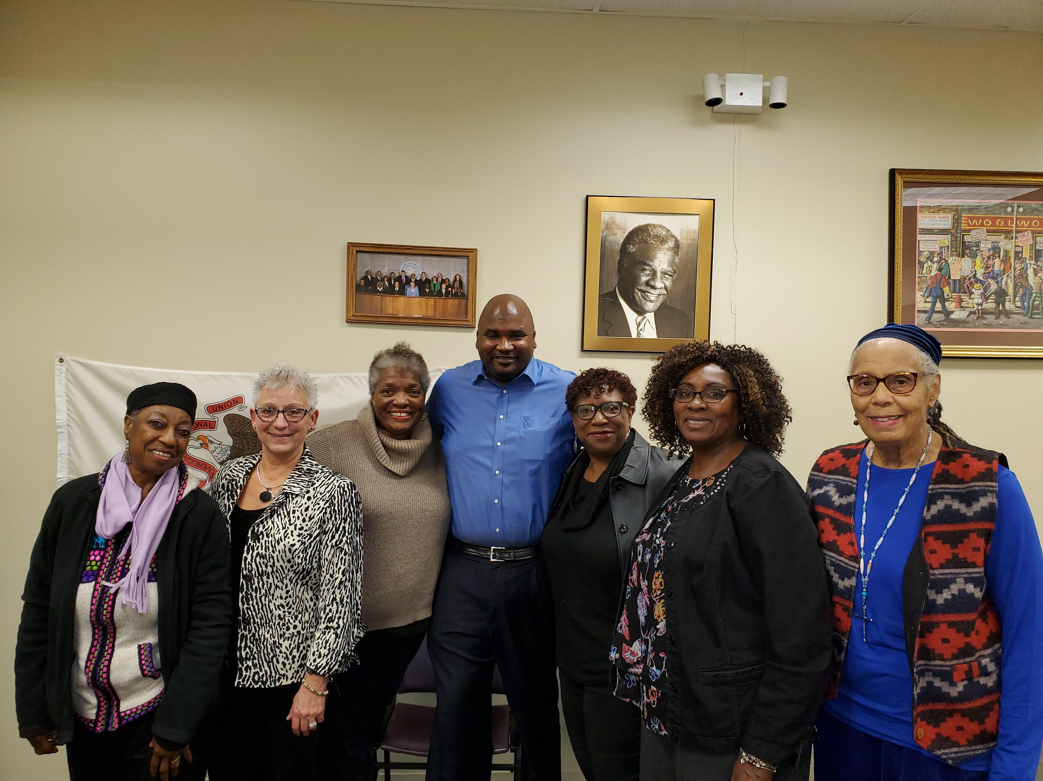
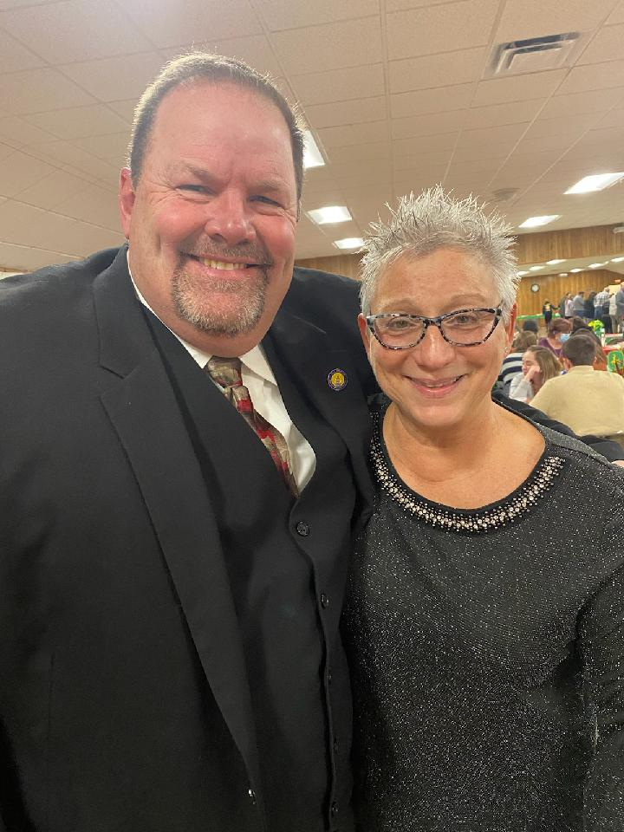
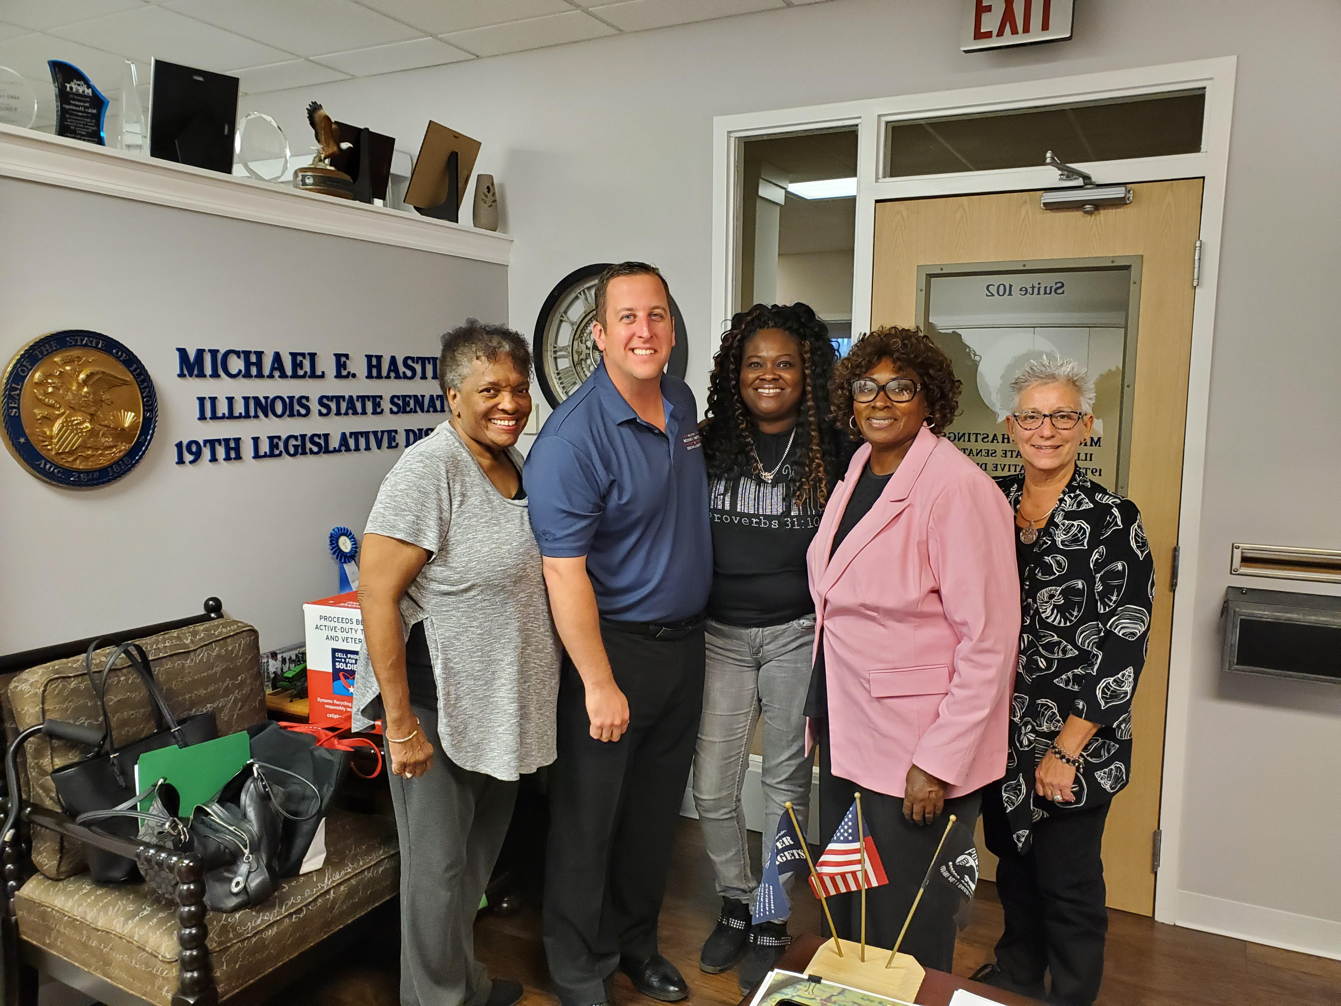

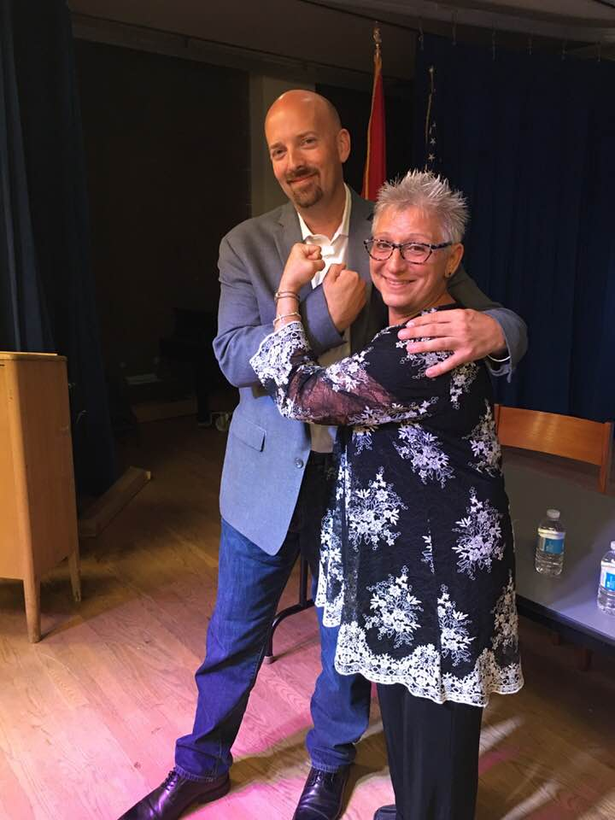
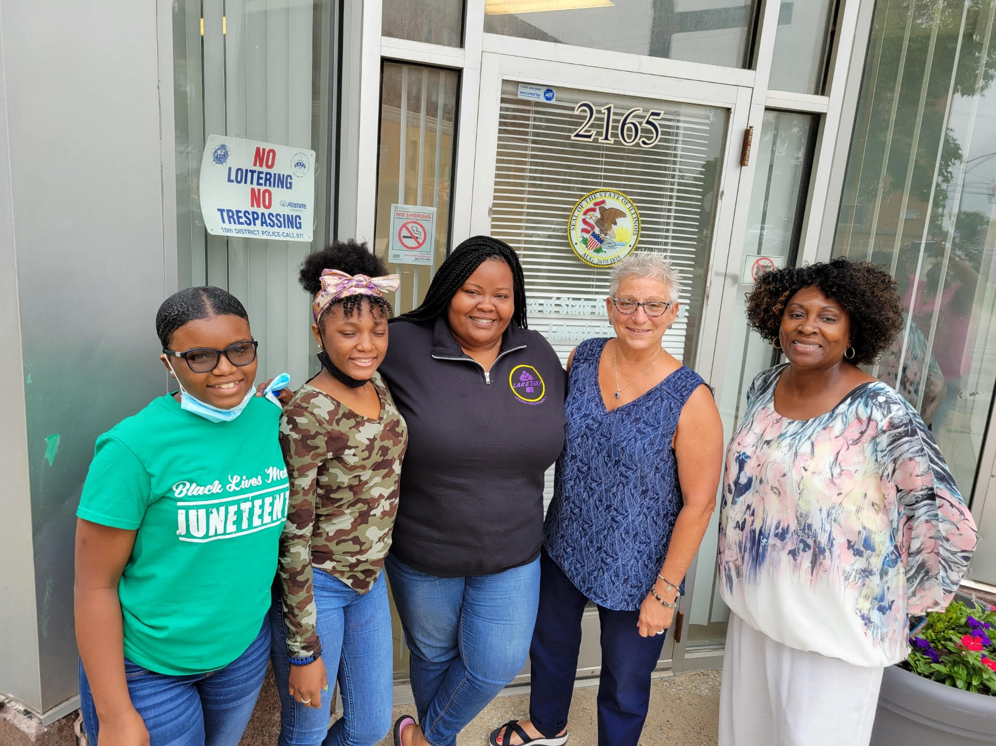
ccnbna NURSES & LEGISLATORS

Slide 18


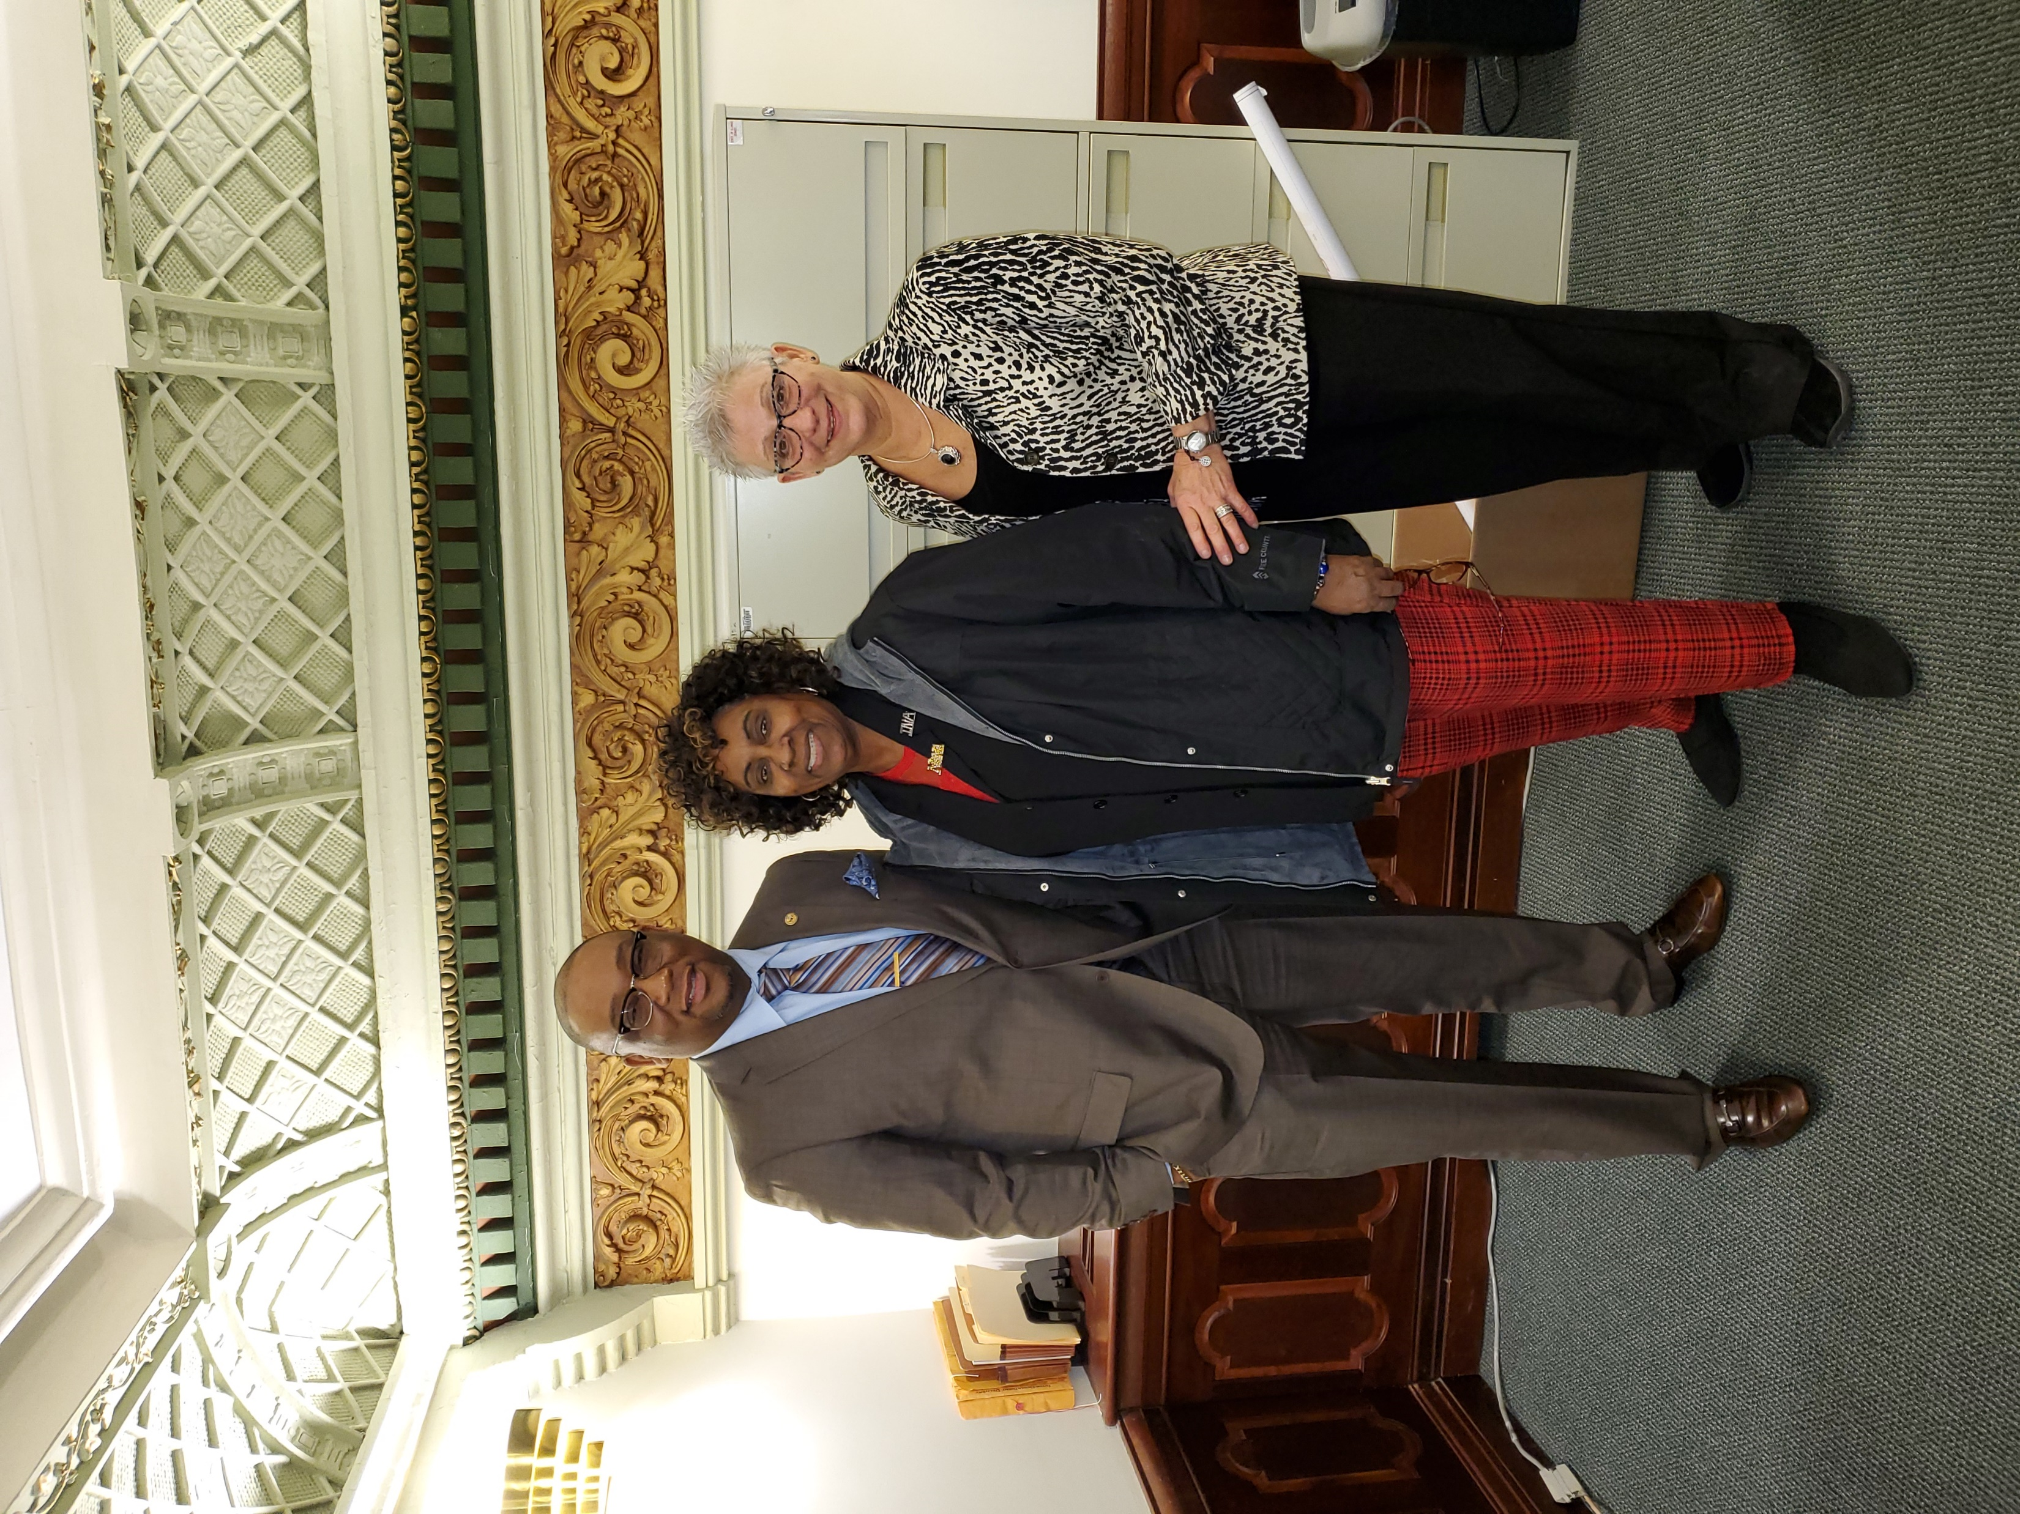
Ccnbna NURSES AT the capitol!

Slide 19
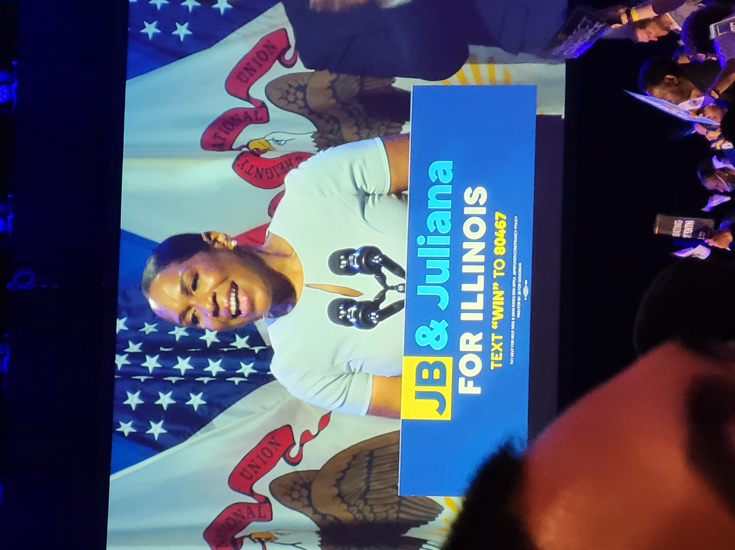
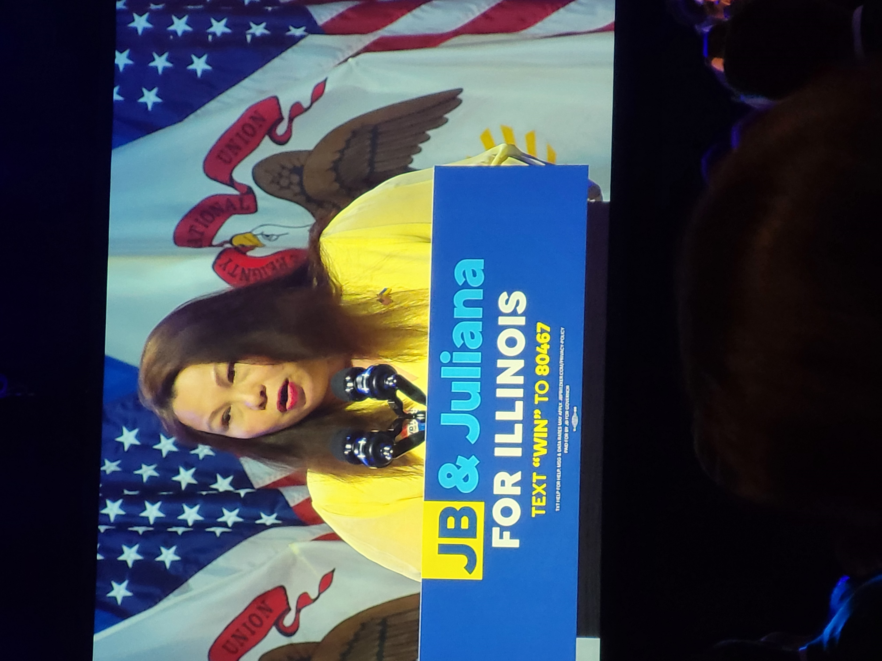
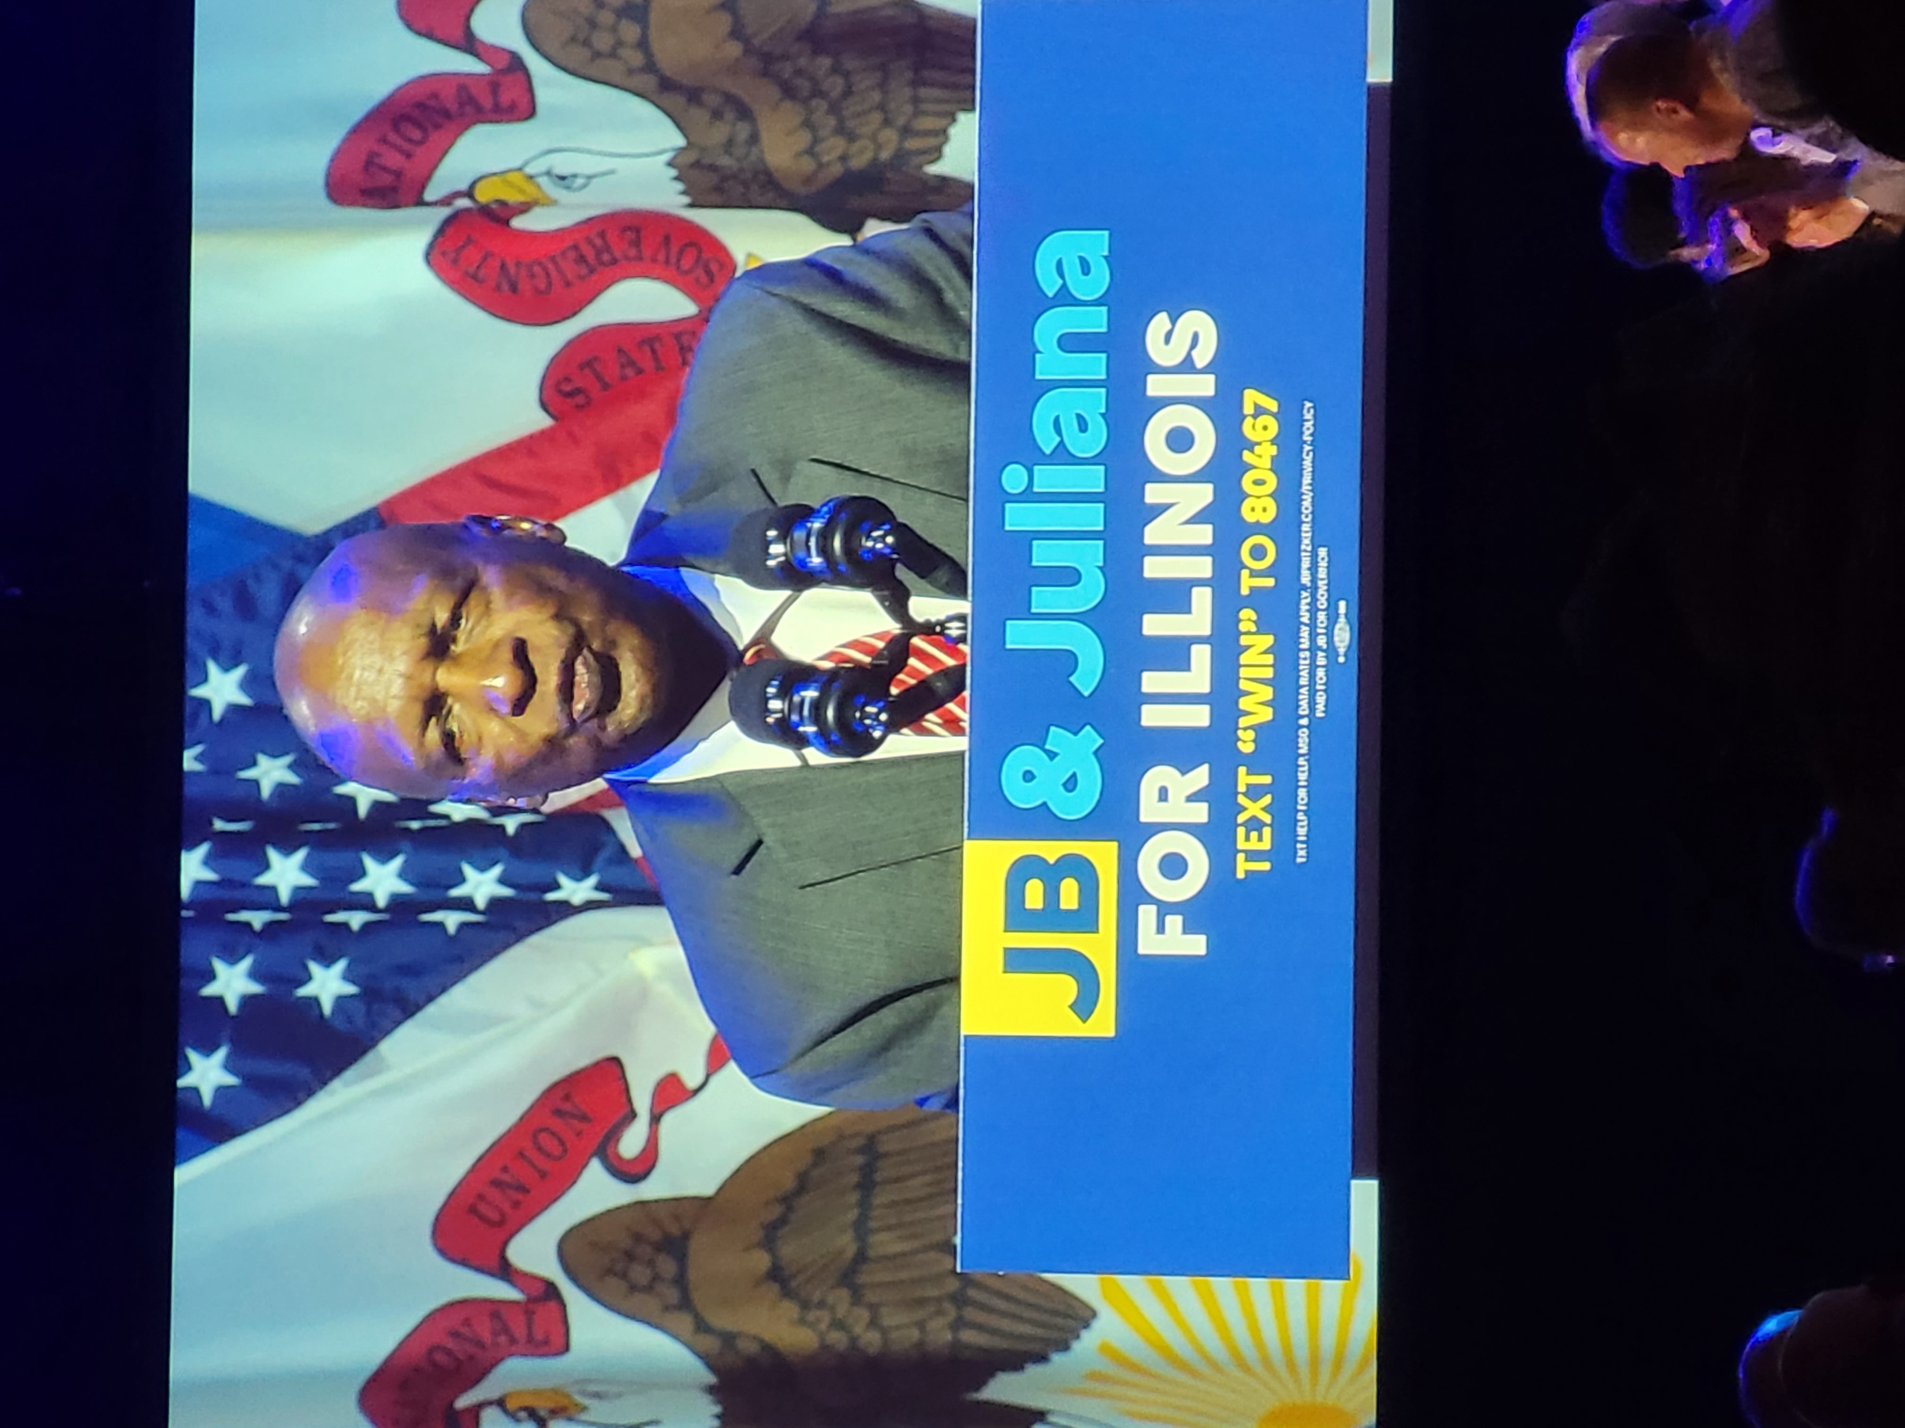
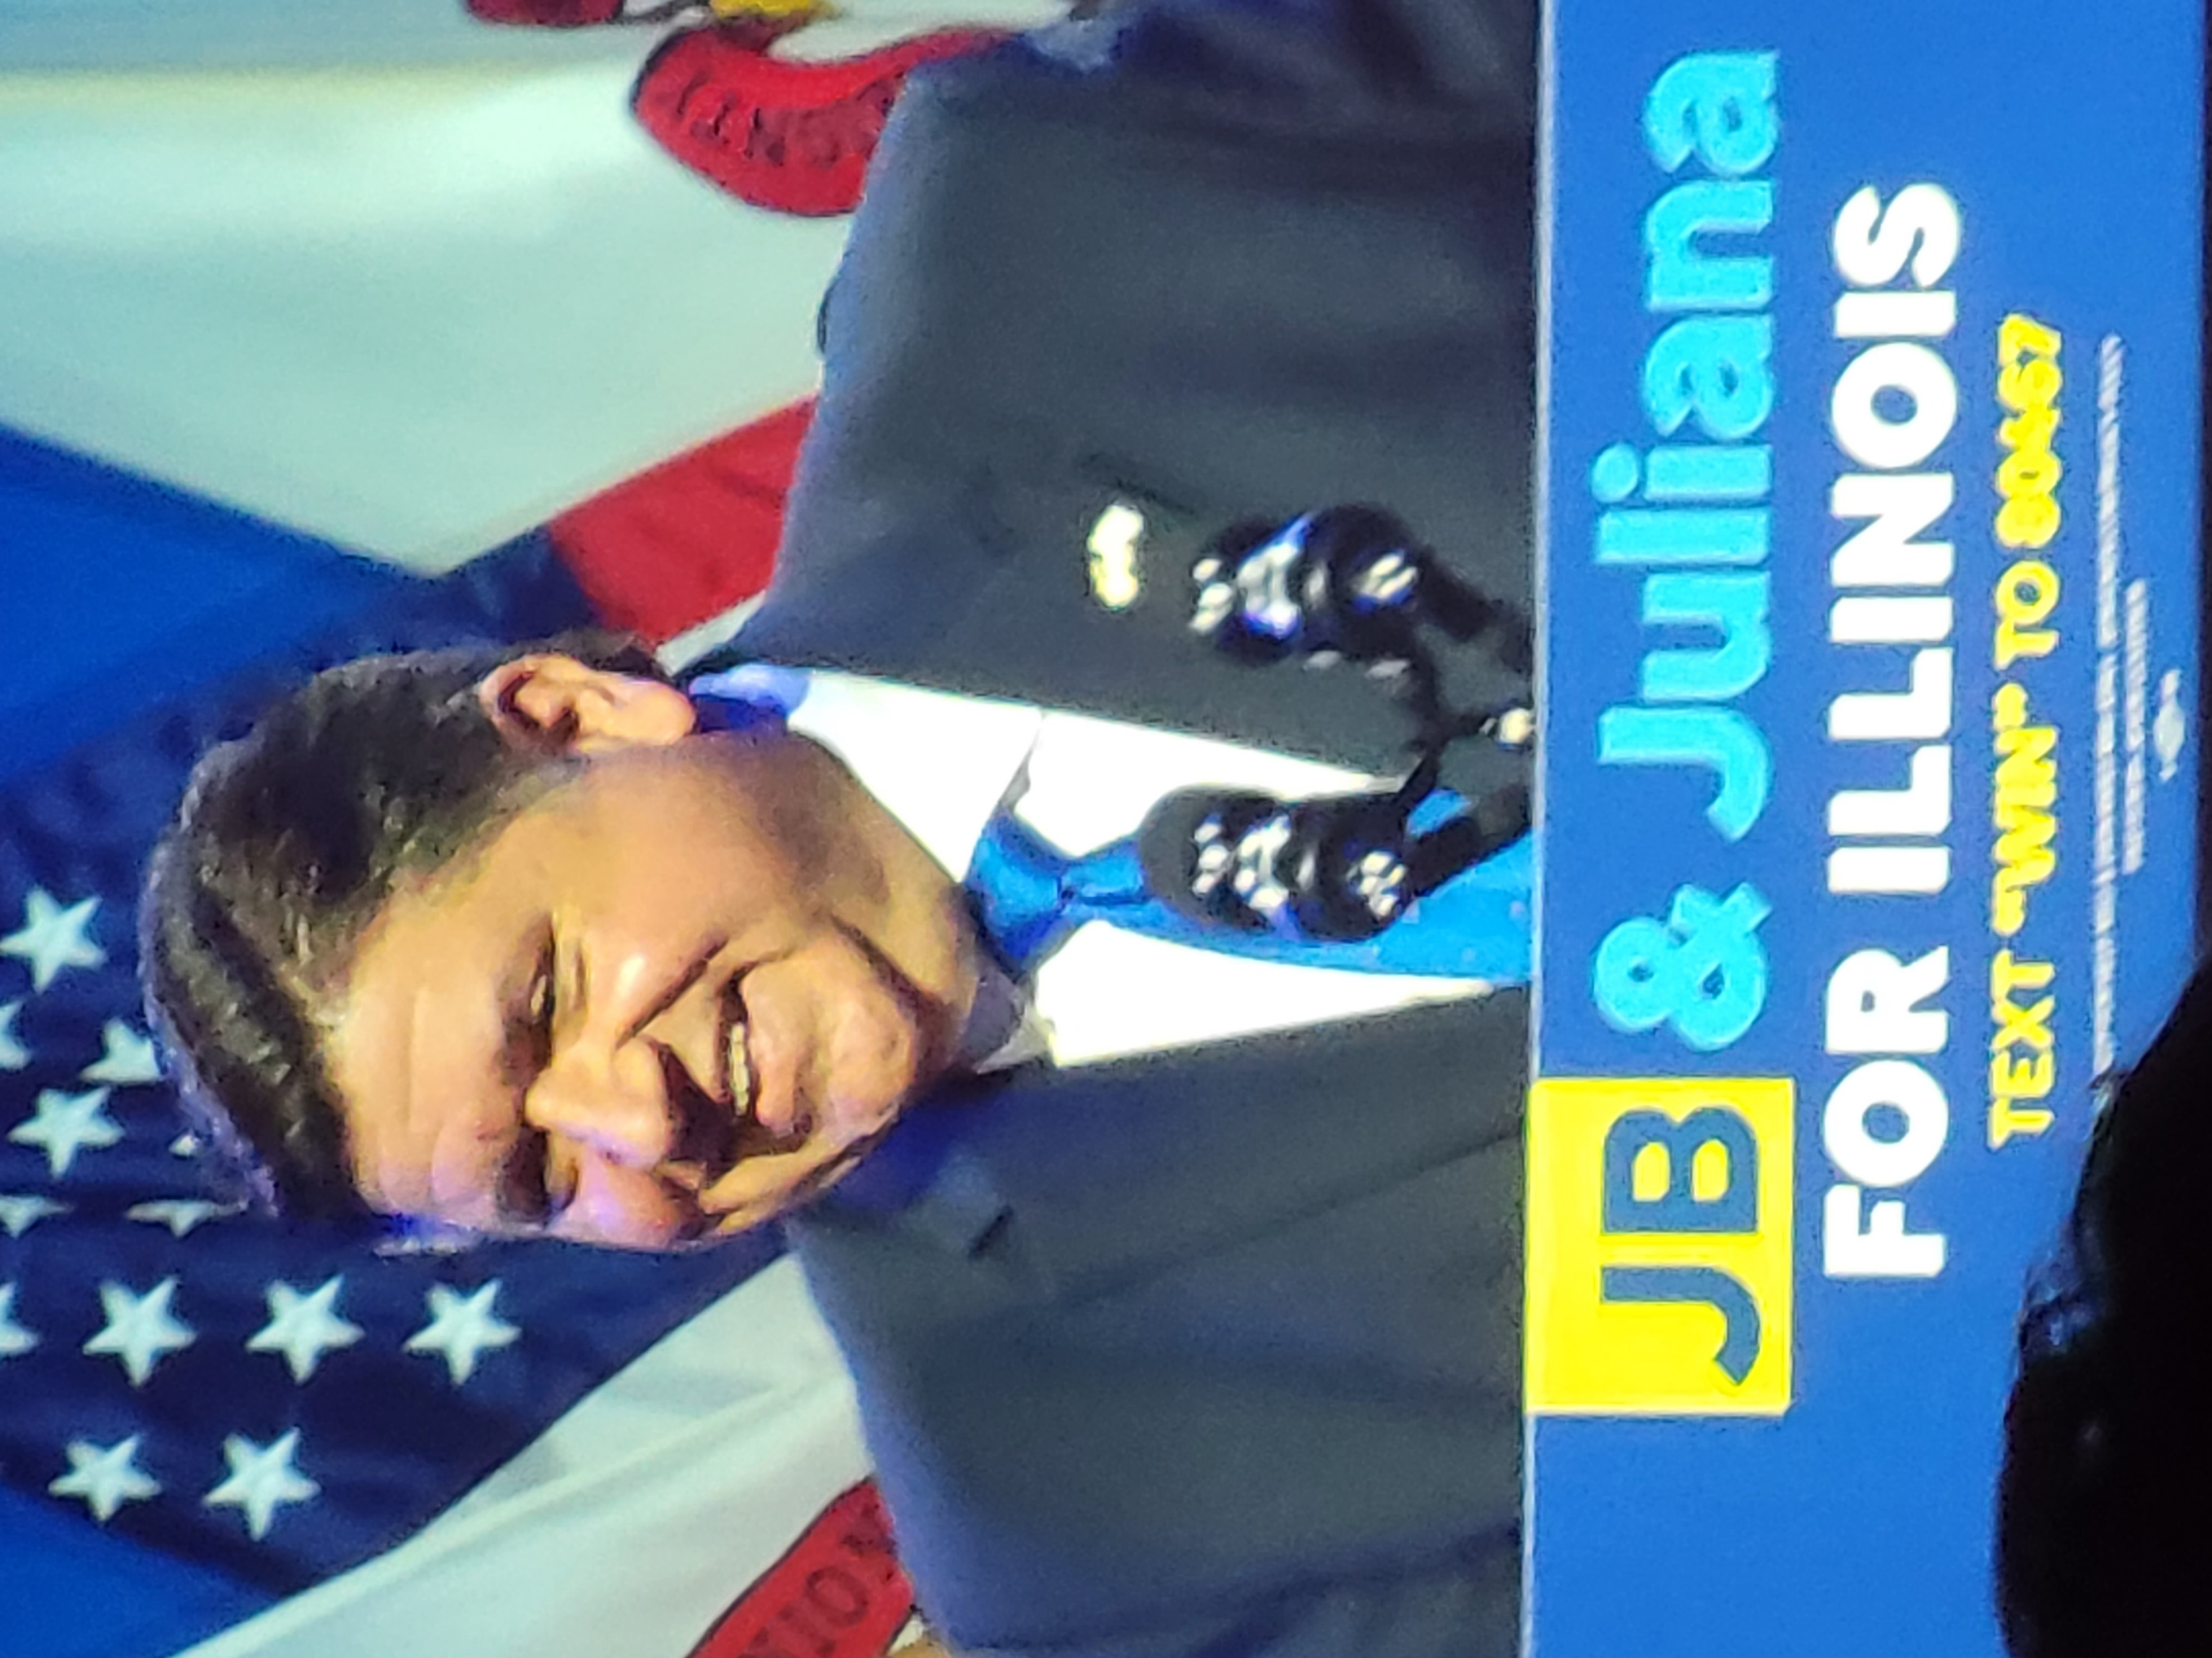
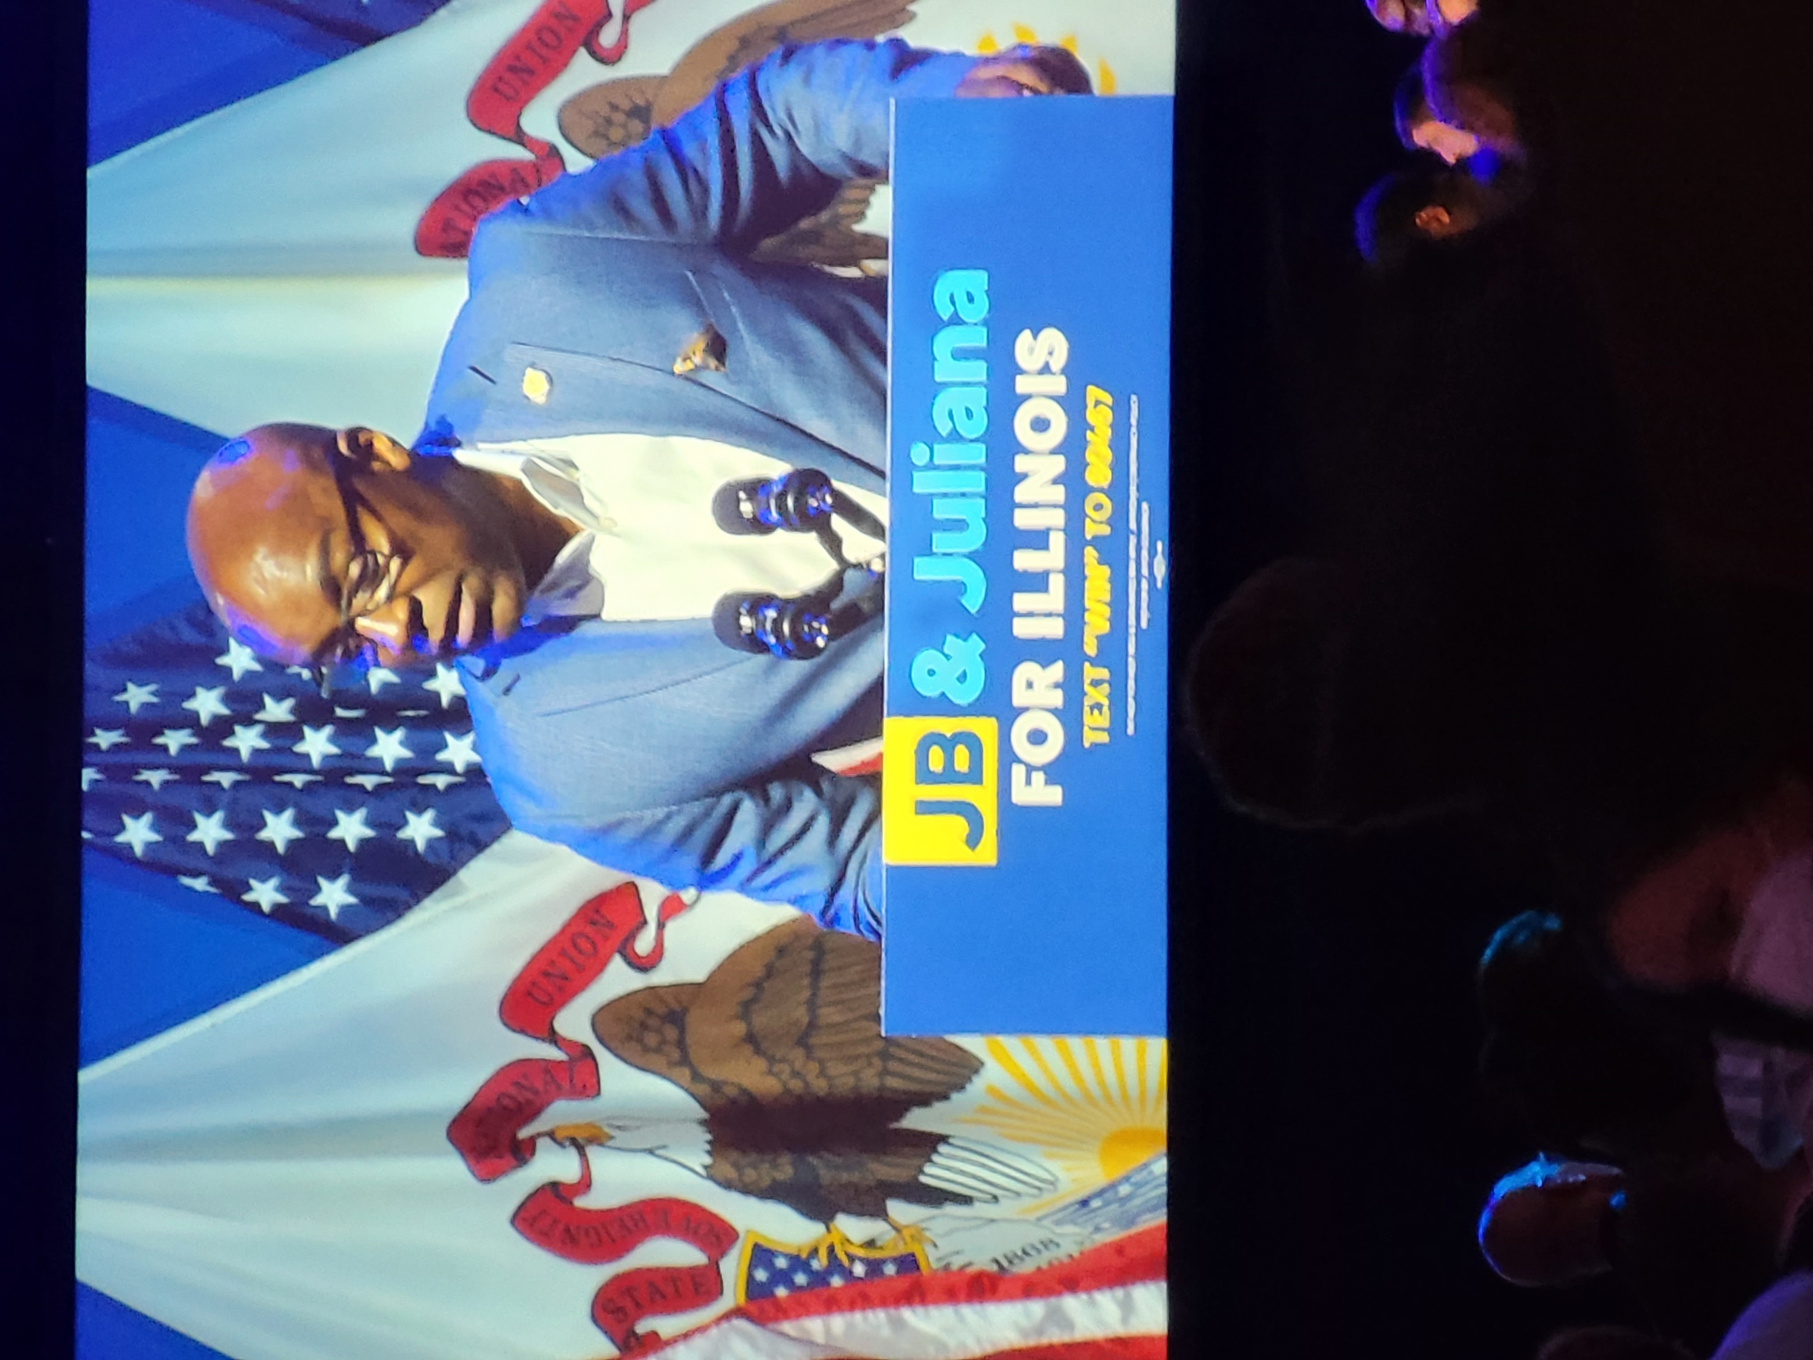

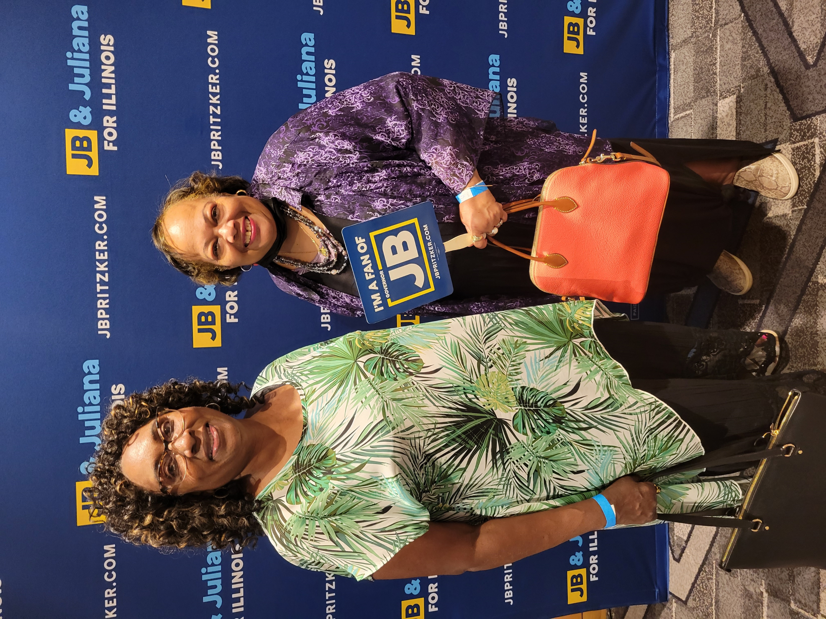
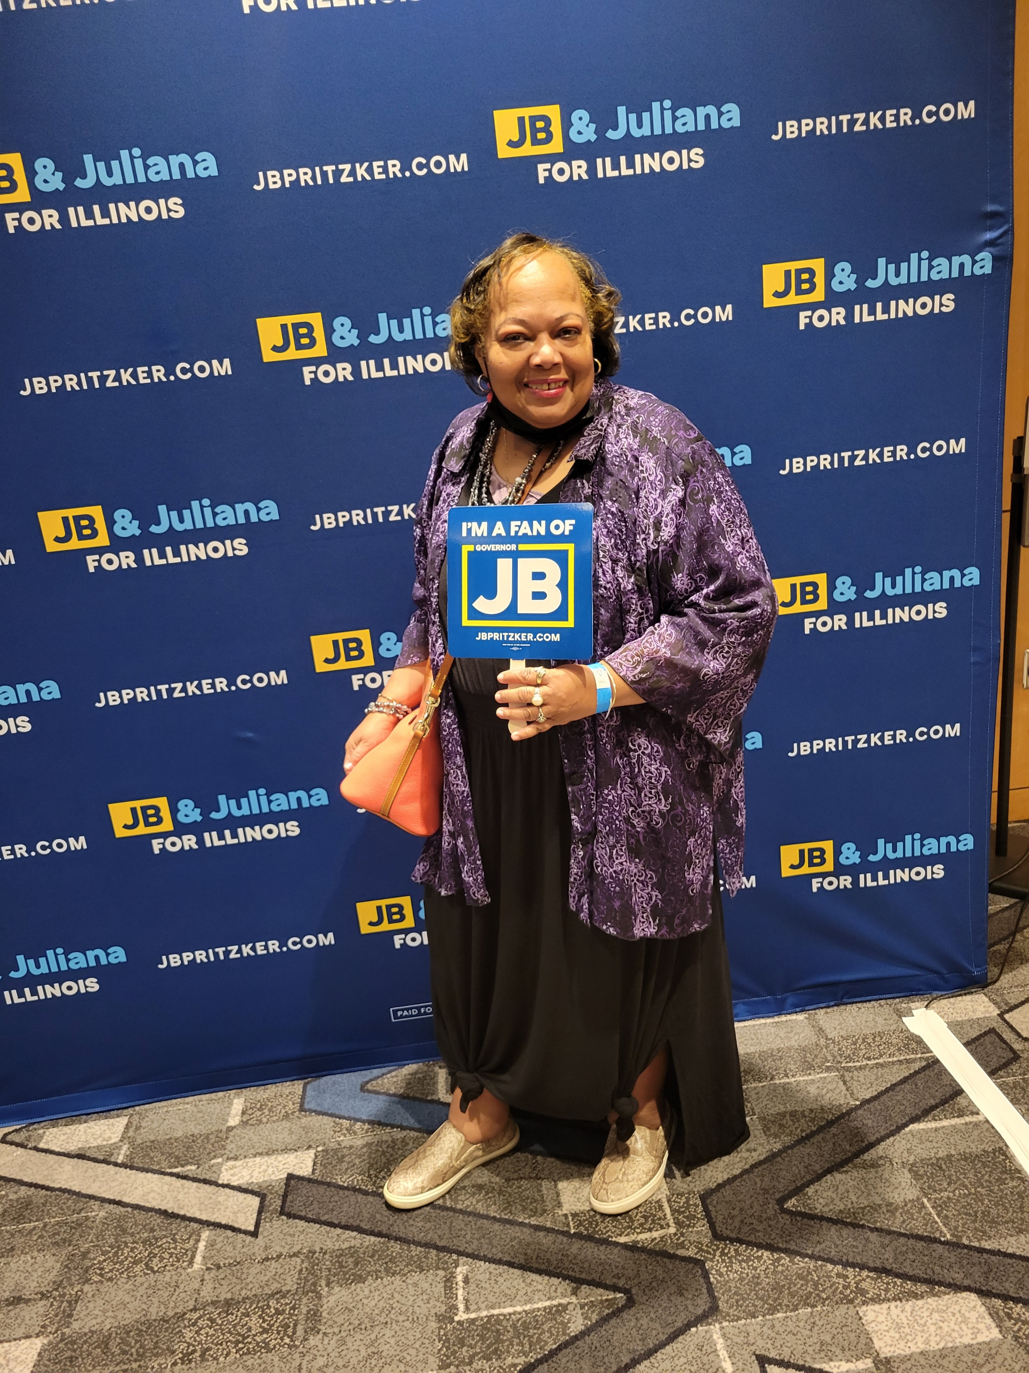

PRIMARY ELECTION CELEBRATION

Slide 20

SENATE Bill 1990 FACT SHEET I
President Ethel Walton RN
SUPPORT SB 1990/HB 4478- RESTORE SAFE DELEGATION BY REGISTERED NURSES
SB1990 Chief Bill sponsor Sen. Emil Jones III – HB4478 Chief bill sponsor Rep. Debbie Meyers-Martin
The Chicago Chapter National Black Nurses Association (CCNBNA) respectfully request your support on SB 1990/HB 4478 restoring that only qualified (educated) and authorized (licensed) nurses practice nursing in all care settings. Restore delivering equal, safe nursing care as delegated by the registered nurse to diverse patient populations including the Community Settings (clinics & schools)!
Illinois Nurse Practice Act (NPA) allows one to practice as a nurse AFTER you have completed and passed an Illinois State Board of Nursing approved nursing program AND successfully passed a national state nursing licensure exam (NCLEX). IDFPR agency oversight is for licensed nurses’ careers.
WHAT CHANGED? A lower standard of nursing care for community settings was created in the 2017 NPA’s delegation language. In 2017 NPA changes allow registered nurses now to delegate “nursing interventions” to unlicensed, uneducated persons, including medication administration in Community settings (clinics and schools) who can work independently without nursing supervision.
DISCRIMINATORY LOWER STANDARD IN COMMUNITY SETTINGS BY 2017 NPA DELEGATION: RNs are prohibited to delegate nursing interventions inside hospitals. Yet, "Nursing intervention" means any treatment based on clinical nursing judgment or knowledge that a nurse performs… can be delegated to uneducated, unlicensed lay persons by an RN in the Community setting!

Slide 21
SENATE BILL 1990 II
What specific unsafe changes occurred in the 2017 NPA regulation?
• DEREGULATING NURSING BY UNCOUPLING EDUCATION & LICENSURE TO PRACTICE NURSING The NPA Legislative Purpose “The practice of professional and practical nursing in the State of Illinois is hereby declared to affect the public health, safety, and welfare and to be subject to regulation and control in the public interest. It is further declared to be a matter of public interest and concern that the practice of nursing, as defined in this Act, merit and receive the confidence of the public and that only qualified persons be authorized to so practice…”.
• REMOVAL OF THE ROLES OF PROFESSIONAL REGISTERED NURSING IN ITS DEFINITION The definition of professional nursing was gutted removing nursing process and the key role of the knowledgeable nurse to administer medications. Prior 2017, complex responsibilities such as medication administration were prohibited to delegate to unlicensed persons. Now registered nurses can delegate medication administration including injectable medications such as insulin to uneducated, unlicensed non-nurse persons in Community settings (clinics & schools) unsupervised. • THE DEFINTION OF “TASK” WAS REMOVED Prior 2017 medication administration was prohibited to be delegated by an RN to an unlicensed person as it was identified as using nursing knowledge & critical judgment. The definition of “task”, work not requiring nursing knowledge or clinical judgment was removed from the 2017 Act. •
NO EVIDENCE TO EVALUATE THAT MINIMALLY TRAINED PERSONS WERE SAFE TO ADMINSTER MEDICATIONS An Illinois General Assembly Pilot (PA-098-0990) ran from 2016-2019 during the negotiations of the NPA to discern if minimally trained persons were safe and could be delegated by RN to administer medications to patients in nursing homes. 4 participants were in that 3-year Pilot. The Pilot failed – there was no evidence for legislators to determine public safety allowing RNs to delegate nursing interventions to unlicensed, uneducated person UNSUPERVISED including medication administration.
Please VOTE “YES” for SB 1990/HB 4478 to return safety within the Illinois Nurse Practice Act by:
• Restoring the robust definition of nursing delineating clear roles of the registered nurse.
• Restoring the definition of “task” work not requiring nursing knowledge or clinical judgment.
Removing that a nurse can delegate nursing interventions to uneducated & unlicensed persons.

Slide 22
EVALUATION
The Chicago Chapter National Black Nurses Association has gain great support over the last few years after the education of Legislators in Springfield about the flaws in the Nurse Practice Act (NPA) and reaching out to stakeholders.
The Chicago Chapter has gain support of major nurses' organizations, labor organizations, individual nurses, and other stakeholders.
The conveners of the last Nurse Practice Act in 2017, does not have the last word in Springfield since the legislators are paying attention now. The conveners of the NPA had to meet with Chicago Chapters leadership and Senator Emil Jones III. About SB 1990.
The nurses in the community setting and hospitals are paying more attention and actively participated in grassroots action by calling their legislators and supporting SB 1990. Evidence by the witness slips on the State of Illinois website.
Senator Emil Jones III suggested to do a subject Matter hearing for Chicago Chapter National Black Nurse Association during Veto session in November 2022. The stakeholders and Nurses will be given an opportunity to speak about how the changes in the Nurse Practice Act affected practice and patient safety.
The CCNBNA and supporters stopped the passing of ANA-ILL Nurse compact Bill that were hosted by the conveners of the NPA. Evidence by the witness slips on the State of Illinois website.

Slide 23
PROJECT OUTCOME
Strength
Weaknesses
In 2022 Chicago Chapter made legislative progress with SB 1990 after grassroots activities and strategic plan.
Chicago Chapter NBNA gain support with other nursing organization after bringing them up to date about the nurse practice Act.
Chicago Chapter; INA; NNU; AFL-CIO; Teacher union; South Suburban Chapter; Nurse Alliance Chapter, and individual stakeholders.
Change in Chief Sponsor to Senator Emil Jones III, led to many senators signing on in 2022.
Chief sponsor Senator Emil Jones III will schedule a subject matter hearing during veto session in Nov 2022.
Chicago Chapter still can have a positive outcome with SB 1990 after testimony from various Nurses.
The Chicago Chapter NBNA and group alliance did a fantastic job filling out witness slips for supporting and opposing legislation in 2022.
Fighting off the opposing group of SB 1990 because of their history with some legislators.
Undoing the damage made in the 2017 Nurse Practice Act.
The hearing with ANA-ILL, the two Senators, and a few school Nurses almost stopped some of the gains Chicago Chapter made with SB 1990.
Senator Emil Jones put off meetings with Chicago Chapter for one month and did not return messages.
The opposing side was putting out information that Senator Jones III was not going to call SB 1990 and he did not share it with the Chicago Chapter leadership.
Members requires more grassroots training with the legislative process and communication.
The medication administration Pilot study failed that were initiated by ANA-ILL. Only four participant were in the study.

Slide 24
REFERENCES
1. Amendment to the Illinois Nurse Practice Act Senate Bill 2151. Retrieved February 28, 2019 from http://ilga.gov/legislation/fulltext.asp?DocName=&SessionId=108&GA=101&DocTypeId=SB&DocNum=2151&GAID=15&LegID=120375&SpecSess=&Session=
2. Bylaws., (2021). Chicago Chapter national black nurses' association. Retrieved June 3, 2022, from Chicagochapternbna.org website.
3. Health Policy Goals and Objectives.(2021). Chicago chapter national black nurses' association. Article XI section 3.
Retrieved June 3, 2022, from Chicagochapternbna.org website.
4. Huber, D. L. (2006). Management Principles. In Huber, D. L., (3rd Ed), Leadership and nursing care management (pp. 33-58).
Philadelphia: Saunders Elsevier.
5. Huber, D.L.(2006). Change and innovation. In Huber, D. L., (3rd Ed), Leadership and nursing care management (pp. 805-826).
Philadelphia: Saunders Elsevier.
6.. Joan Gratto Liebler and Charles R. McConnell. (2012). Management Principles for health Professionals. In Joan Gratto
Liebler and Charles R. McConnell., (6th Ed), Today’s concept of organizational management (pp. 53-89). Sudbury: Jones & Bartlett Learning, LLC.
7. Nurse Practice Act, 225 IL.C.S. §§65-5-65 (2007). Retrieved March 3, 2019, from https://www.brcn.edu/sites/brcn/files/NursePracticeAct.pdf
8. Nurse Practice Act, 225 IL.C.S. §§65-5-65 (2017). Retrieved March 3,2019, from
http://www.ilga.gov/legislation/ilcs/ilcs5.asp?ActID=1312&ChapterID=24
9. Wirth, Ross,. A. (2004). Lewin and Schein’s Change Theory.

